Slide 1

Amazon mobile app

Slide 2
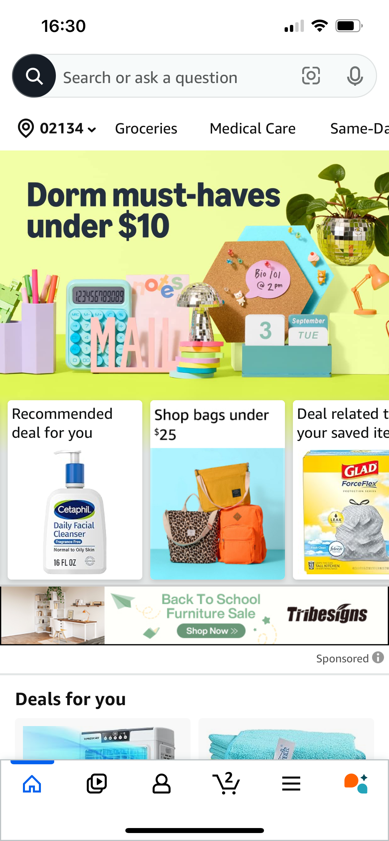
Pros
The home page shows where the user left off from their last visit and suggests deals based on their recent searches and purchase history.
Easy access to frequently used features like groceries and in-store codes is available from the home page.
The layout is simplified, ensuring the user is not overwhelmed by too much information.

Slide 3
Cons
Users cannot customize the app layout (e.g., disabling certain features like "Shorts" or "Rufus"). There should be an option for users to select which features they want in the bottom area.
The app continues to recommend products that have already been purchased in the same category or bought a long time ago. Users should have the option to provide feedback on recommendations (e.g., liking or disliking a product suggestion by long pressing the item).
The app does not have a dark mode.

